Slide 1
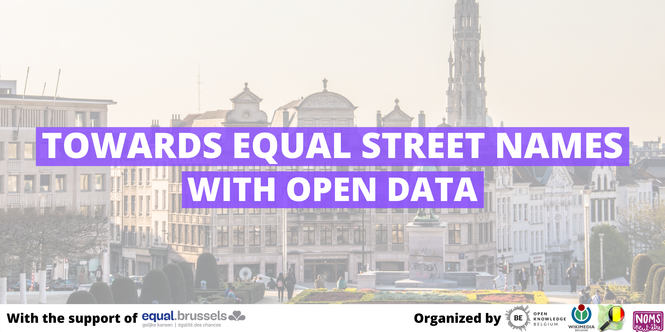
This is your presentation title

Slide 2
Hello!
And thank you for coming!
(Really, thank you. You are making this possible).

Slide 3
The city should represent all of us.
Names of public spaces define the identity of a city and how we interact with it
Brussels has a major imbalance: together, let’s help fix that!
Together and thanks to Open Data, we will create a map to visualize the imbalance!

Slide 4
EqualStreetNames.Brussels
Project in two phases:
Mapping the imbalance in the 19 municipalities in Brussels
8 workshops organized until November (once/month) to come up with suggestions for municipalities.
First one: March!

Slide 5


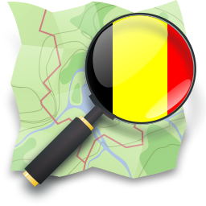


Partners
Made possible by
Organized by

Slide 6

How can we build a map using #OpenData?
OpenStreetMap Data + Wikipedia Data (Wikidata) =

Slide 7
Why Linked Open Data
Using a software:
Not replicable for other cities
Unknown algorithm
Error %
Using Open Data:
Open and fully transparent
Small error margin
Other cities can replicate the project
Documentation: https://github.com/geo6/equalstreetnames
Contributing to OpenStreetMap & Wikipedia
Community
Plenty of new opportunities! Eg: analysis, profile suggestions...
Linked Open Data:
When link made = always there
Notes:
Beyond basic analysis
Replicate

Slide 8
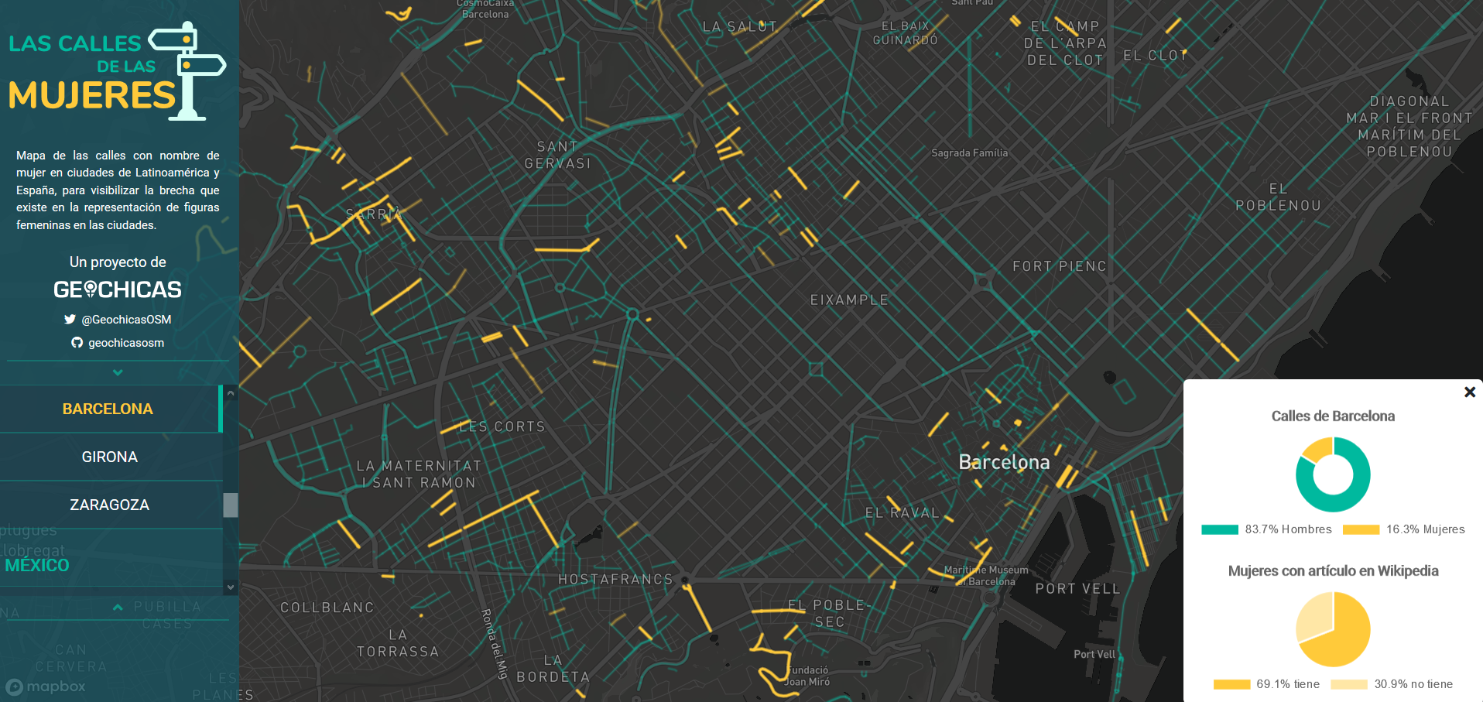
Expected result: examples

Slide 9
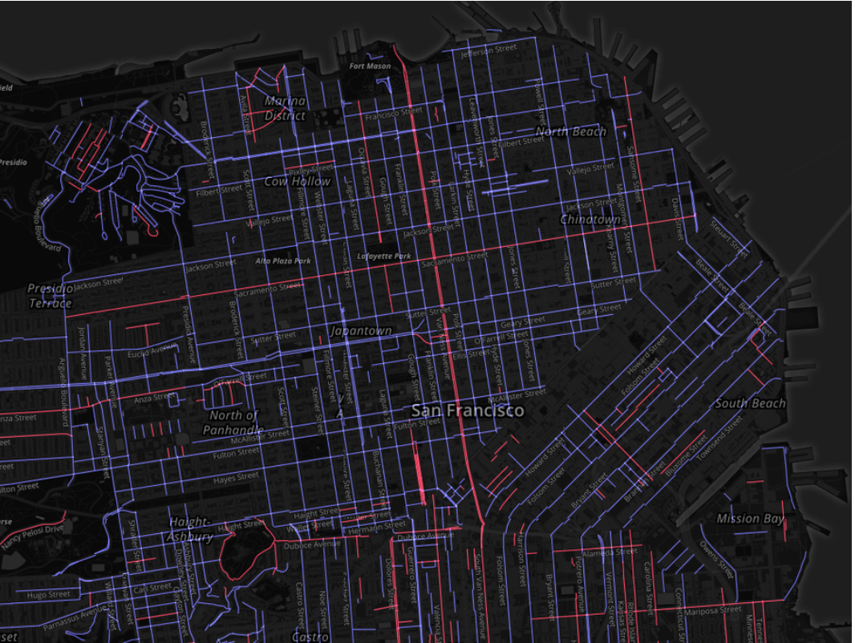

Slide 10
Technical guide: how to link the data
We promise it’s NOT
complicated!

Slide 11
6,200+
Streets in Brussels!
Woluwe Saint-Pierre/Sint-Pieters-Woluwe: 370
Watermael-Boitsfort/Watermaal-Bosvoorde: 284
Uccle/Ukkel: 507
Schaerbeek/Schaarbeek: 394
Saint-Josse-ten-Noode/Sint-Joost-ten-Node: 139
Woluwe-Saint-Lambert/Sint-Lambrechts-Woluwe: 343
Ixelles/Elsene: 367
Ganshoren: 142
Evere: 193
Etterbeek: 223 Berchem-Sainte-Agathe/Sint-Agatha-Berchem: 151
Auderghem: 283 Anderlecht: 543 Saint-Gilles/Sint-Gillis: 177
Molenbeek-Saint-Jean/Sint-Jans-Molenbeek: 331 Koekelberg: 102 Jette: 243
Bruxelles/Brussels: 1374
Forest/Vorst: 217
Notes:
Rajouter villes

Slide 12
The process is easy
Step 1: Split into 19 groups
Step 2: Go to http://bit.ly/listingbrussels

Slide 13
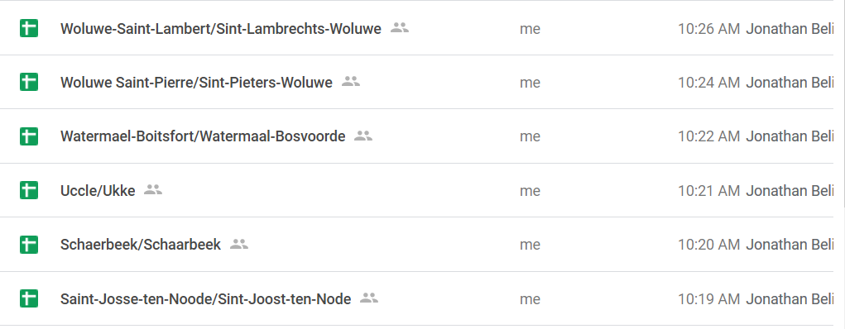
Step 3 : Click on the document of your municipality
Psssss: this presentation is
also in that folder!

Slide 14
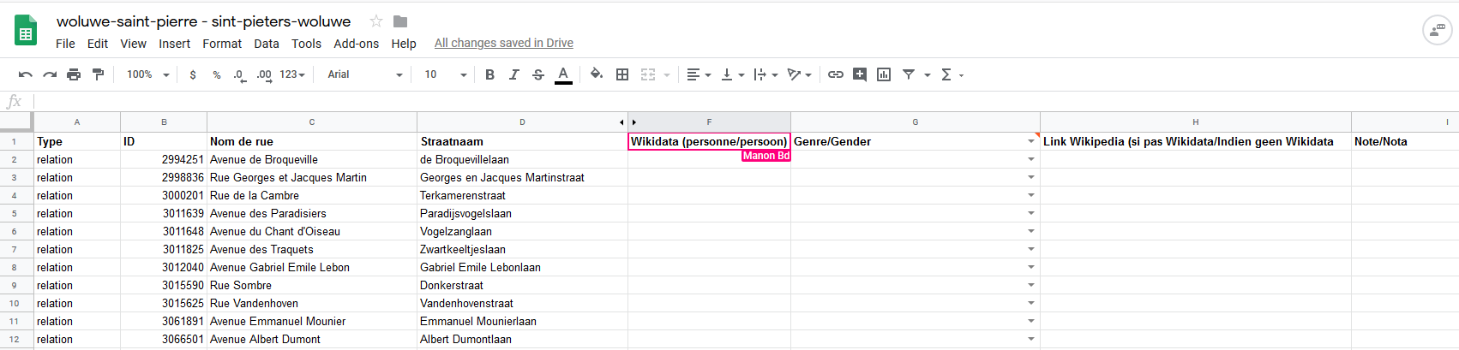
Step 3.1: You arrive on this page
Street Names FR
Wikidata Tag
Wikipedia Link
Street Names NL
Gender
Note

Slide 15
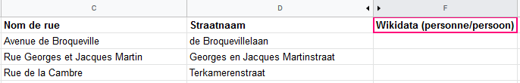
Step 4: Adding the Wikidata Tag
4. 1. Check on WikiData
Click on this link: http://bit.ly/wikidatatags
Example: Avenue de Broqueville/de Broquevillelaan

Slide 16
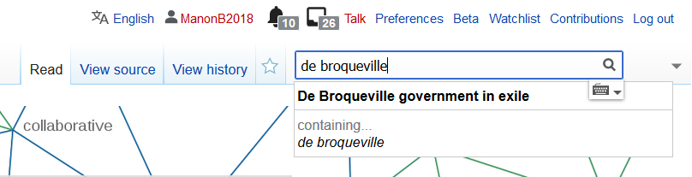
Step 4: Adding the Wikidata Tag
4.2. Type the name of the street in Wikidata
Reminder: http://bit.ly/wikidatatags

Slide 17
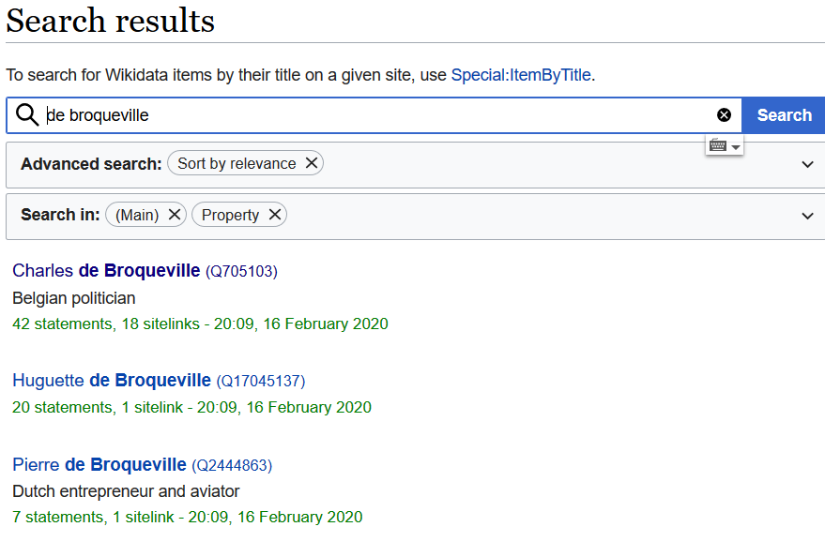
Option 1:
Only one name comes up.
Lucky you!
Option 2:
Different possibilities come up.
It could be Huguette, Charles or Pierre!
Which one is it?

Slide 18
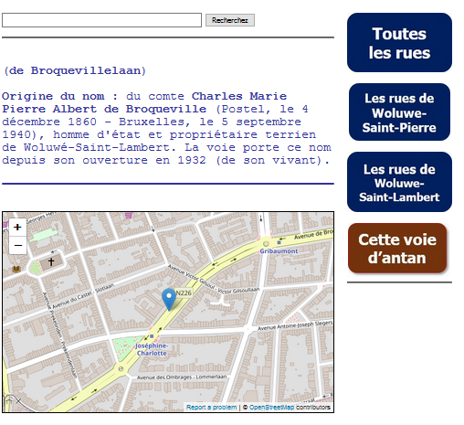
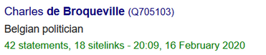
4.3. Finding the right person
Option 2:
Different possibilities come up.
Which one is it?
Go to http://bit.ly/StreetsBrussels
Click on the right municipality
Click on street
Read the history
So that was Charles (of course
it wasn’t Huguette…)

Slide 19

4.4. Writing the Wikidata Tag
Copy paste the tag (always start with Q) in the shared excel document

Slide 20
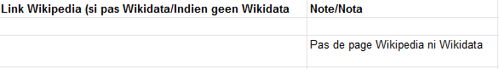
4.5. No Wikidata?
Search on Wikipedia to see if there’s a profile.
YES
copy/paste link
in the Wikipedia Column
NO
Write a comment in the note section

Slide 21

4.6. No Wikidata nor Wikipedia?
Write the full name of the person if known
Example:

Slide 22
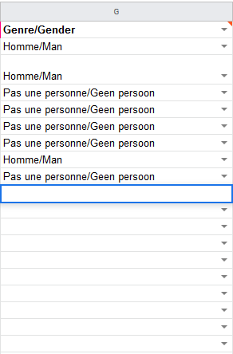
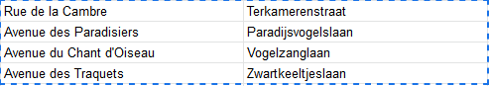
Step 5: Adding the gender
4 possibilities:
Homme/Man
Femme/Vrouw
X
Pas une personne/Geen persoon
= all the streets who don’t have the name
of a person
Example:

Slide 23
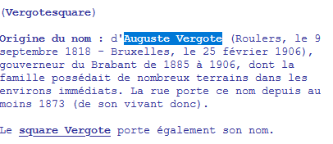
Attention!
Sometimes no first name but still a person!
Example:
Square Vergote (Woluwe St Lambert)
> Rue Vergote
> Auguste Vergote
Always check on
http://bit.ly/StreetsBrussels

Slide 24
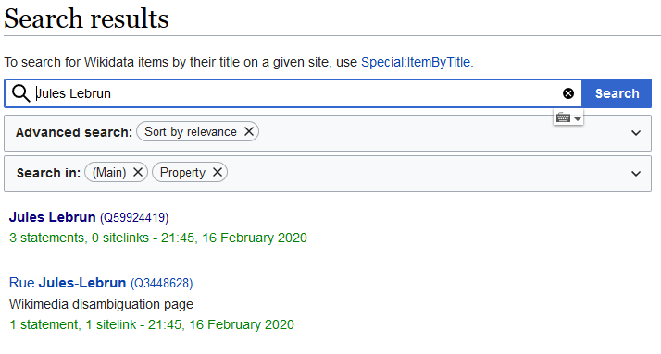
Attention 2: which one to chose, the person or the street?
Always the person!
The street data has been collected already.
Notes:
If not a person, still need to get the Wikidata for the street?

Slide 25
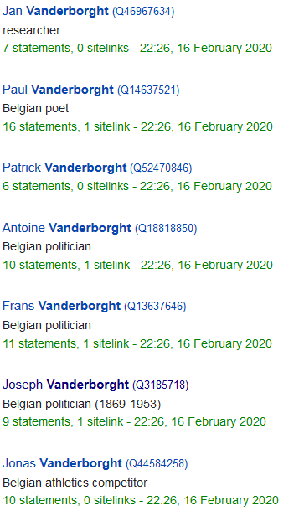

Attention 3: sometimes, it’s impossible to know which one it is!
So many Vanderborght!
If you can’t find it on http://bit.ly/StreetsBrussels, search online.
If you really don’t know, just fill in the Gender.
Notes:
If not a person, still need to get the Wikidata for the street?

Slide 26

Attention 4:
If you don’t find it on the FR Wikipedia, have a look on the NL Wikipedia!
And vice versa of course.

Slide 27

The platform will be published on
03 MARCH 2020
Get ready to make some noise!

Slide 28
Last (but not least)...
Self-service Croque at the back!
& pintjes & juice

Slide 29
Thank you!
Let’s get started!
You can find us at @openknowledgeBE & contact@openknowledge.be

